Slide 1

Results from the 2023 POWER Survey on Parental Leave and Childcare at MIT

Slide 2
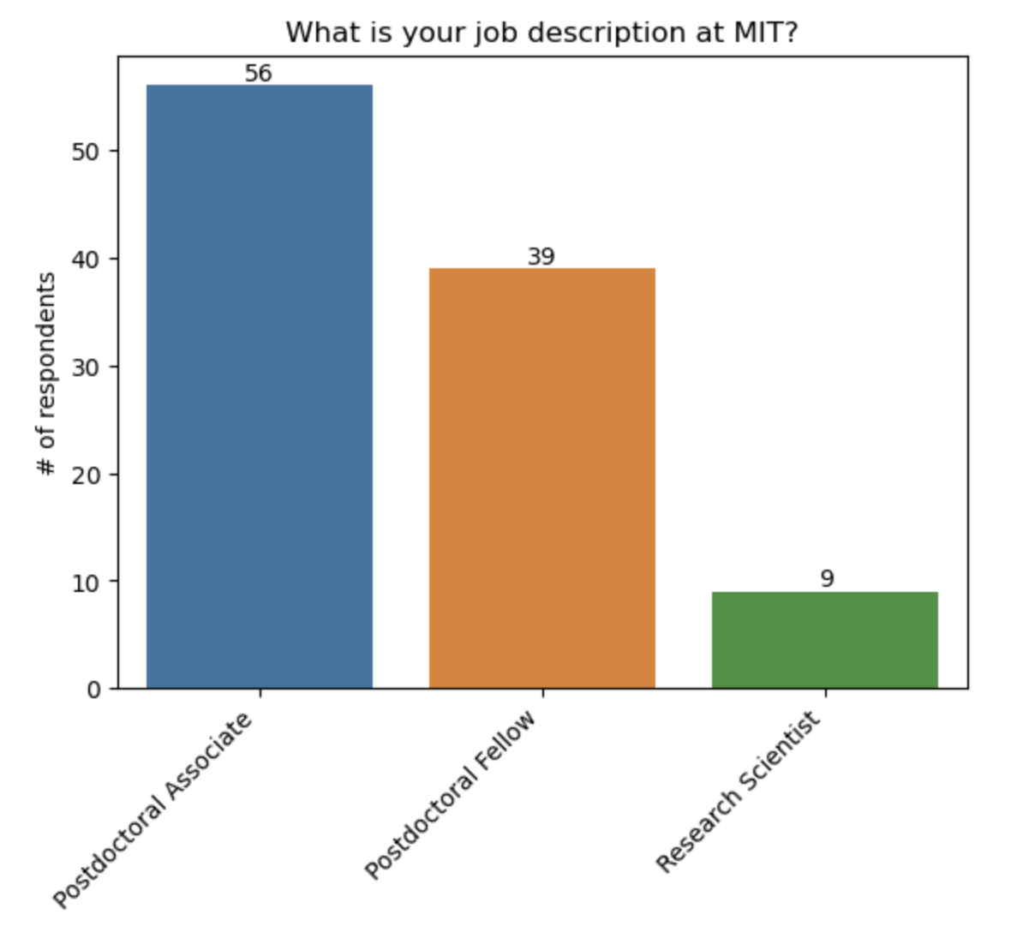
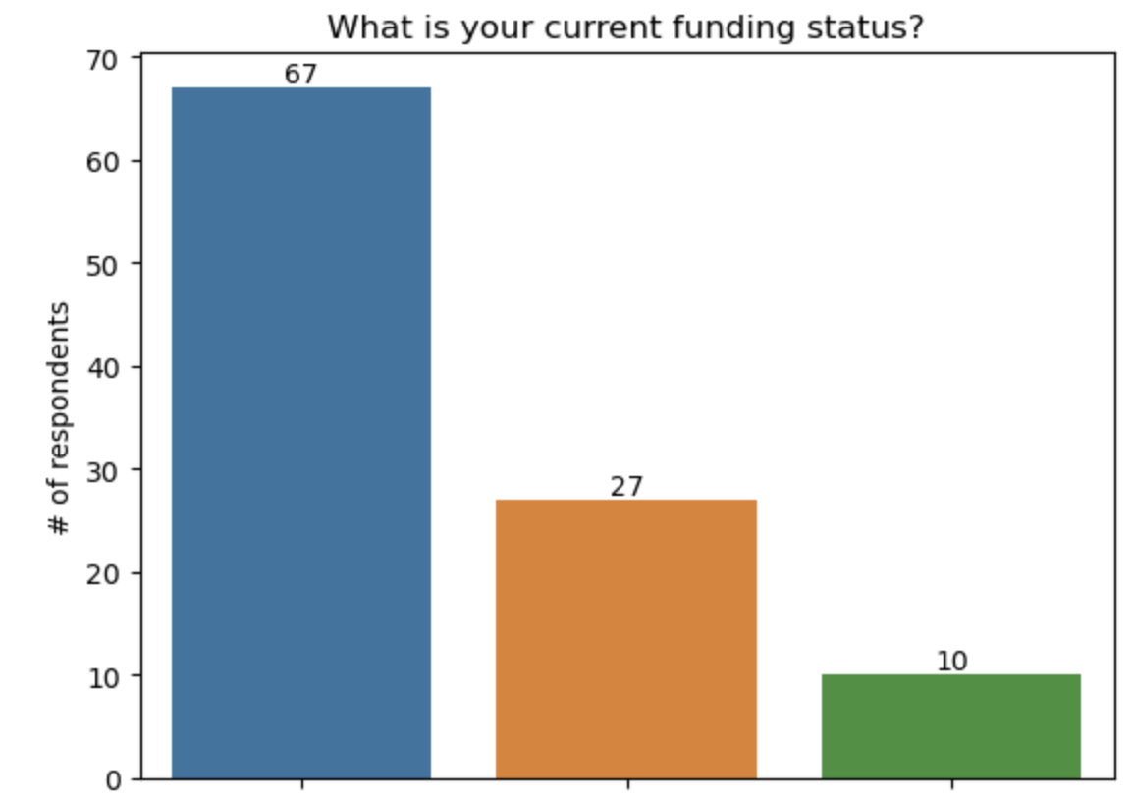
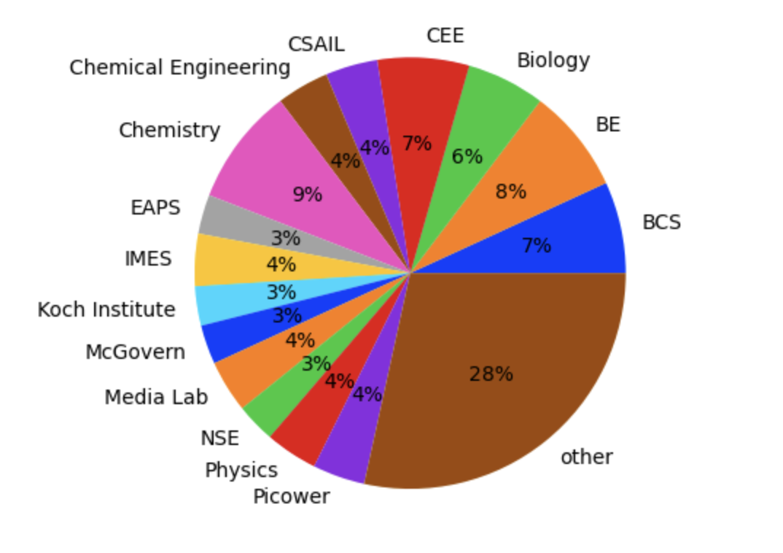
Who responded to the survey?
Internal
External
Combination
Of Both
Majority of respondents are postdoc. associates
Respondents are from 40 unique departments
Majority of respondents receive internal MIT funding
n=104 respondents
Notes:
104 people answered the survey

Slide 3
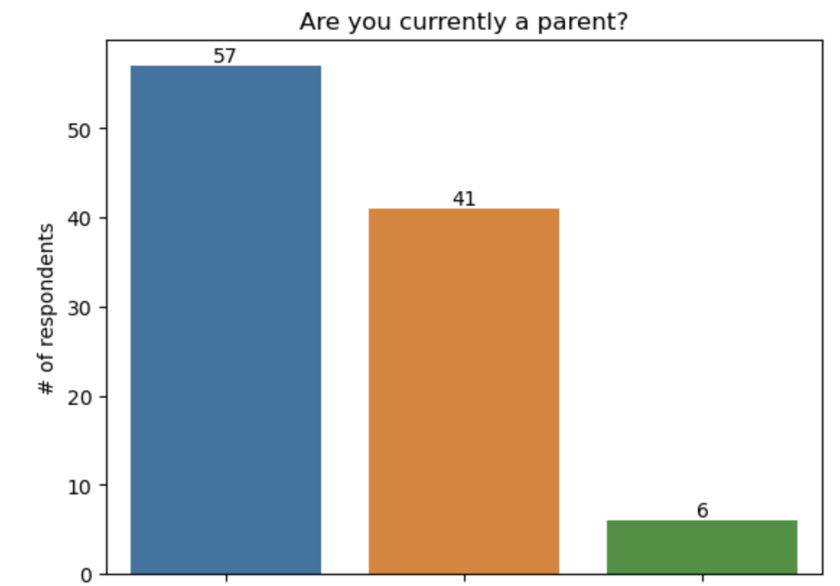
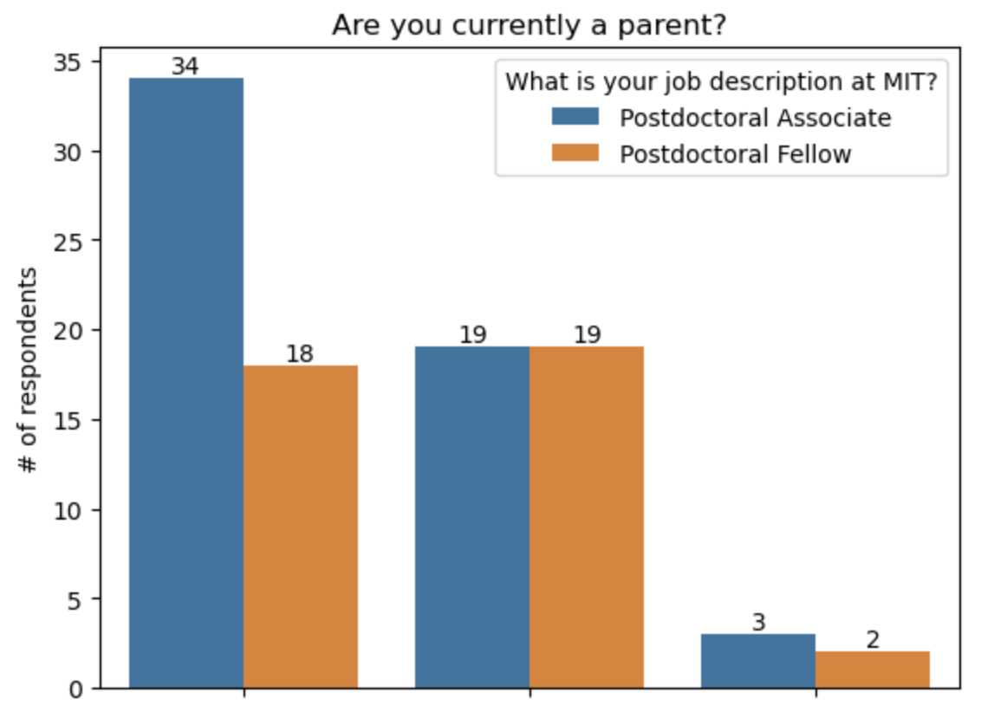
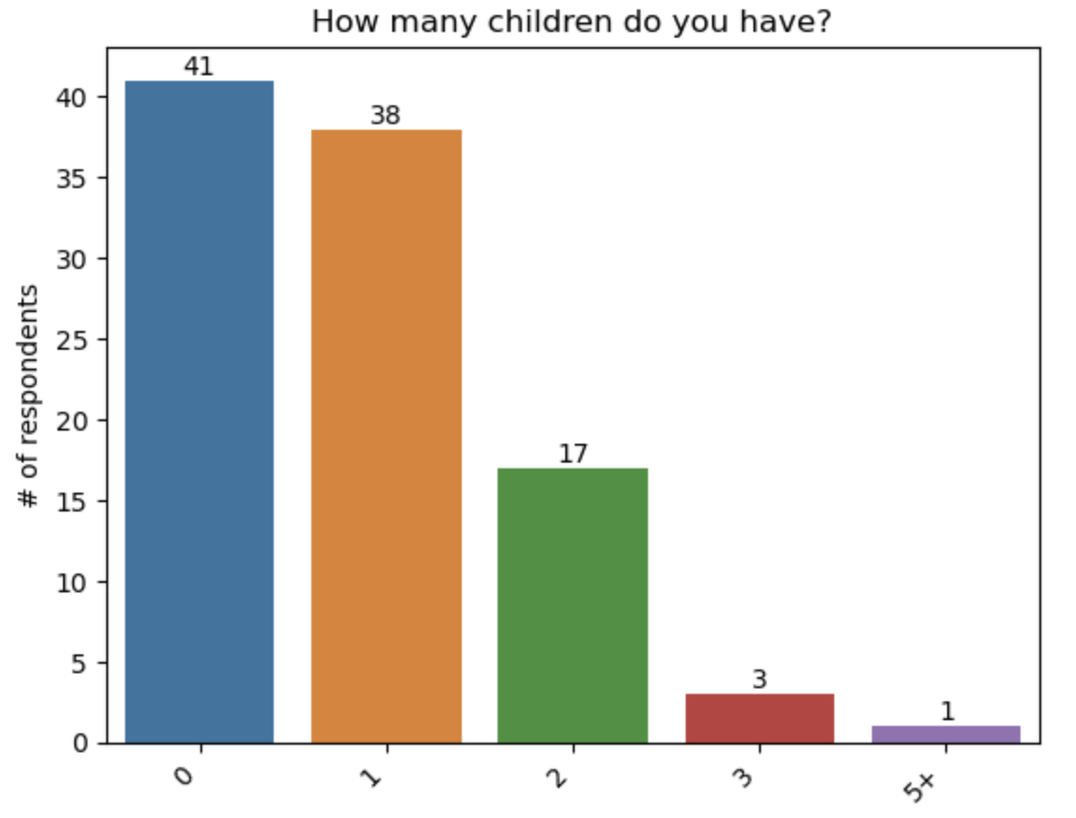
Which postdocs are parents?
Yes
No
Expecting a baby
Yes
No
Expecting a baby
Majority of respondents are parents
More postdoc. associates are parents compared to fellows
Majority of respondents do not have children followed closely by respondents who have 1 child
Notes:
104 people answered the survey

Slide 4
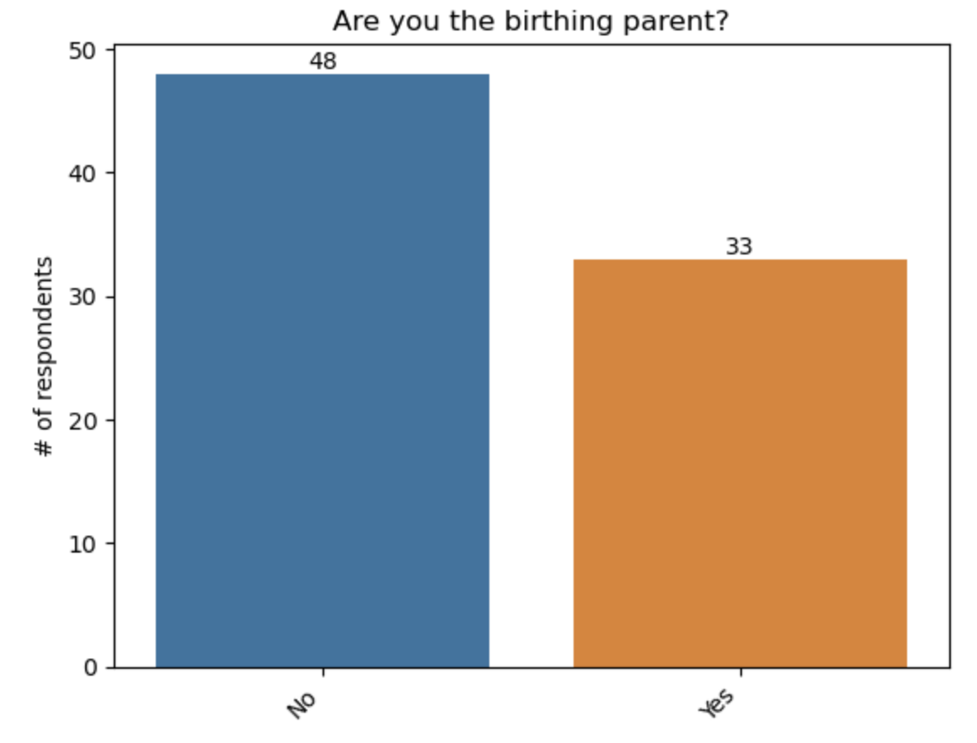
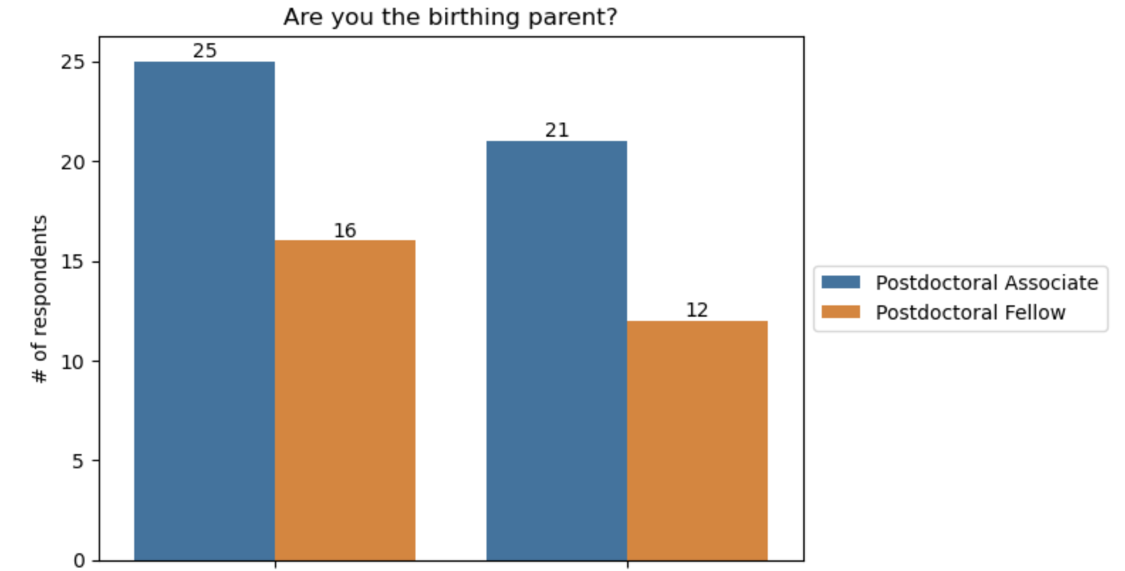
Which postdocs are birthing parents?
No
Yes
No
Yes
Majority of respondents are not the birthing parent
Proportion of associate/fellow respondents is similar across birthing parent and partner
Notes:
104 people answered the survey

Slide 5
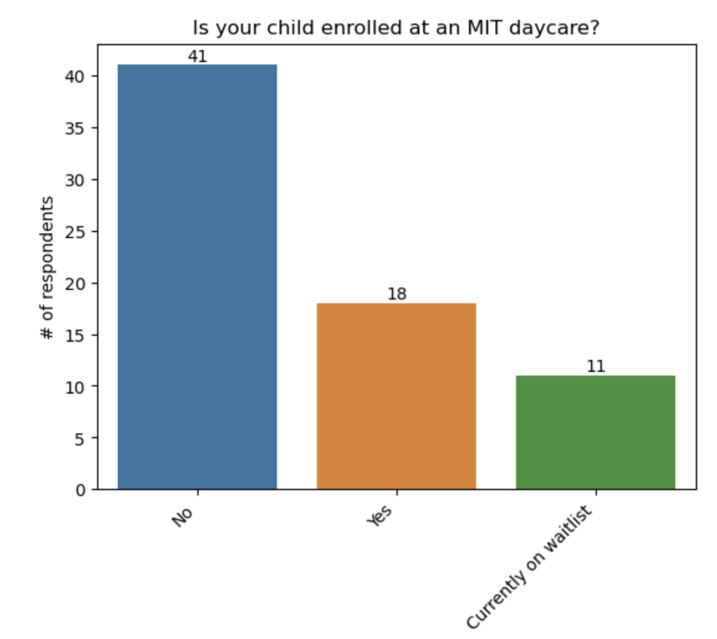
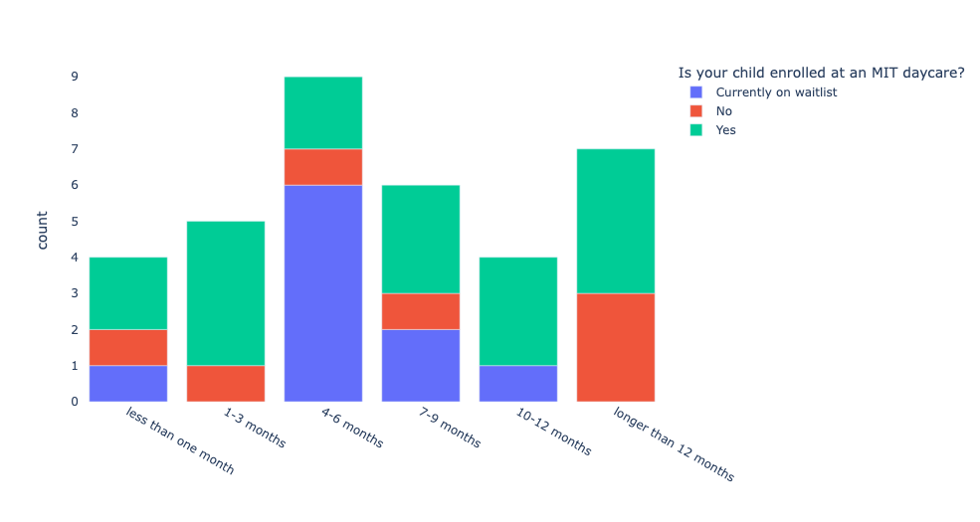
What are the rates of daycare enrollment?
Majority of respondents do not have children enrolled at MIT daycare
Majority of respondents currently on the waitlist have been on list for 4-6 months
Notes:
Some parents who did not enroll at MIT daycare were on the waitlist for longer than 12 months
Majority of respondents currently on waitlist have been on list for 4-6 months
Of those whose child/children are in the daycare, some were waiting less than a months while some were waiting for over a year - lots of variability
Majority of respondents currently on waitlist have been on waitlist for longer than 4 months

Slide 6
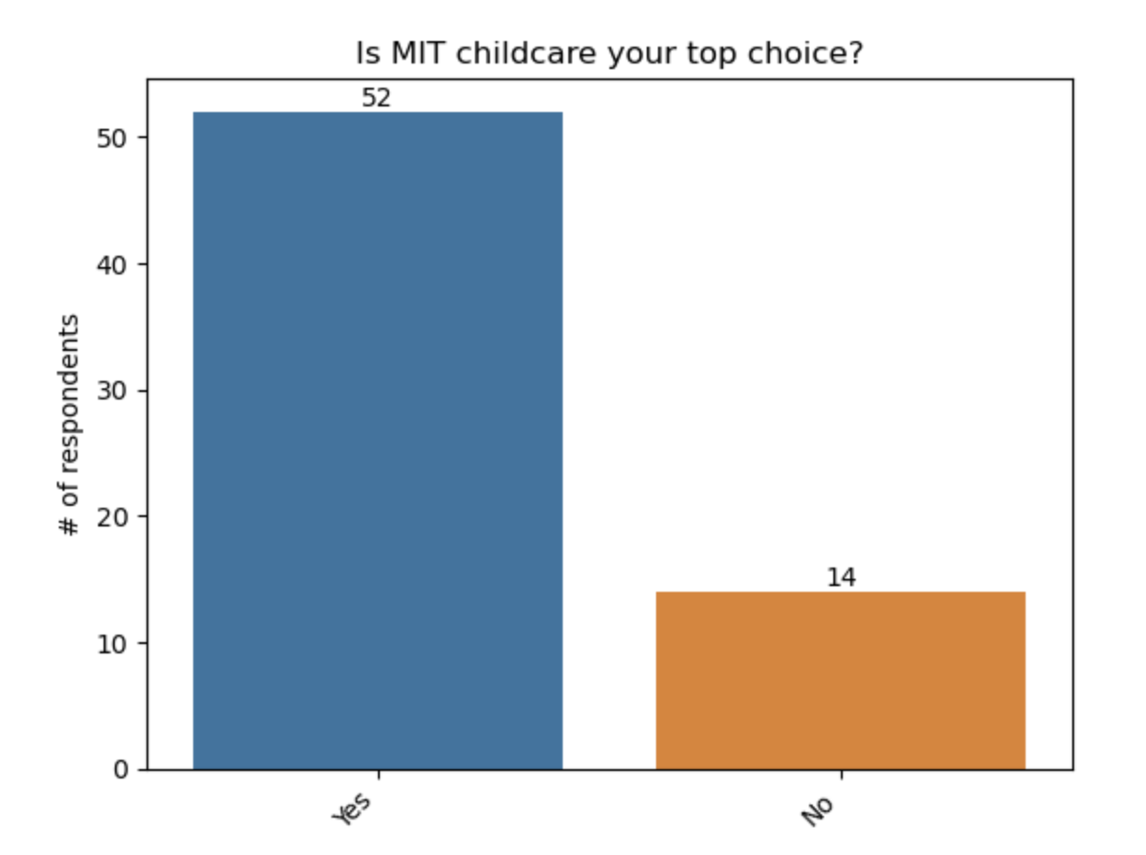
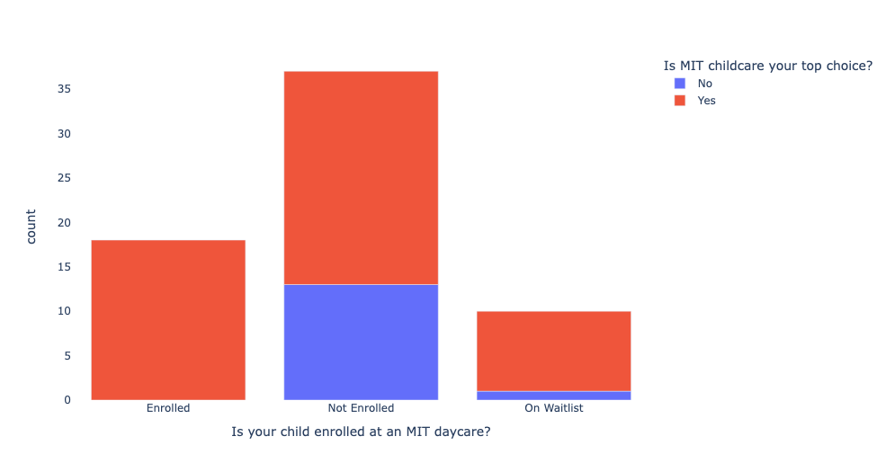
Is MIT daycare the top choice of postdocs?
Vast majority of respondents have MIT daycare as their first choice
Of those whose child was not enrolled, MIT daycare was still their top choice
Notes:
Of those on the waitlist, the majority have MIT daycare as their top choice

Slide 7
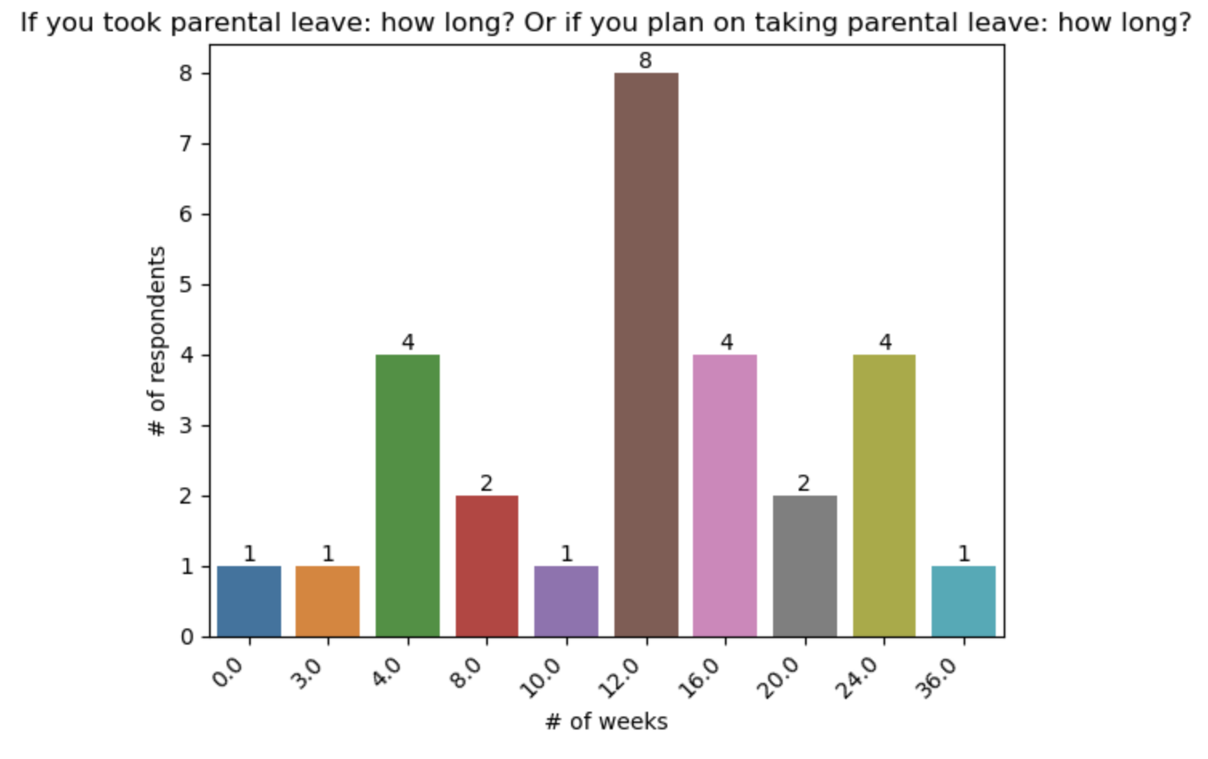
How long are postdocs taking parental leave?
Majority of respondents take 12 weeks leave
Notes:
Those taking longer than 24 weeks did so in other institutions other than MIT

Slide 8
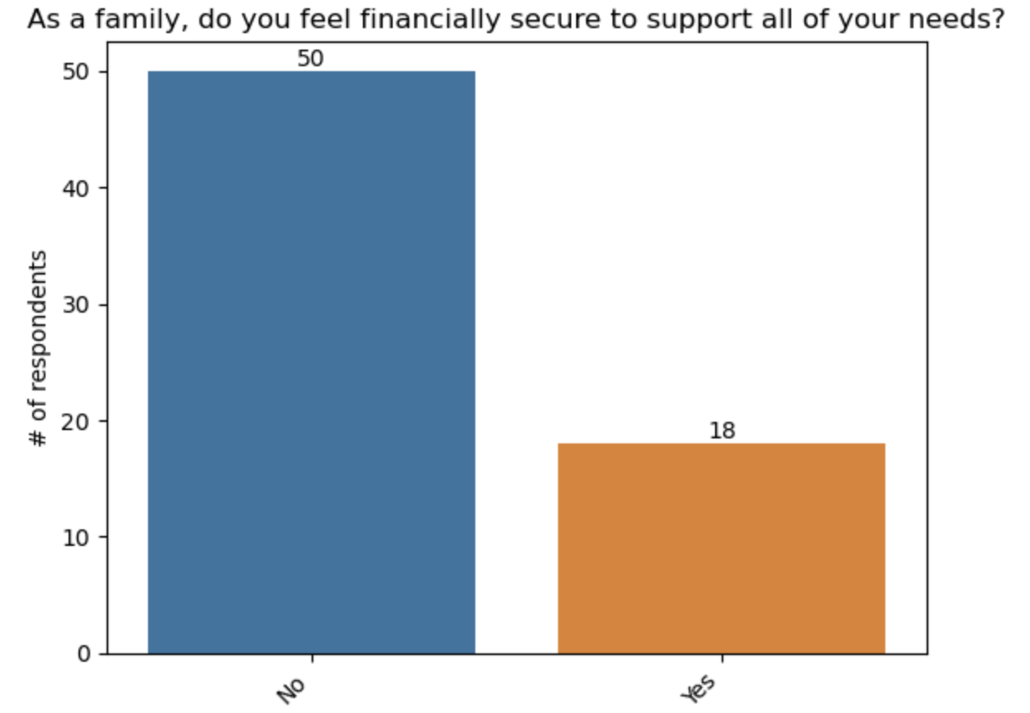
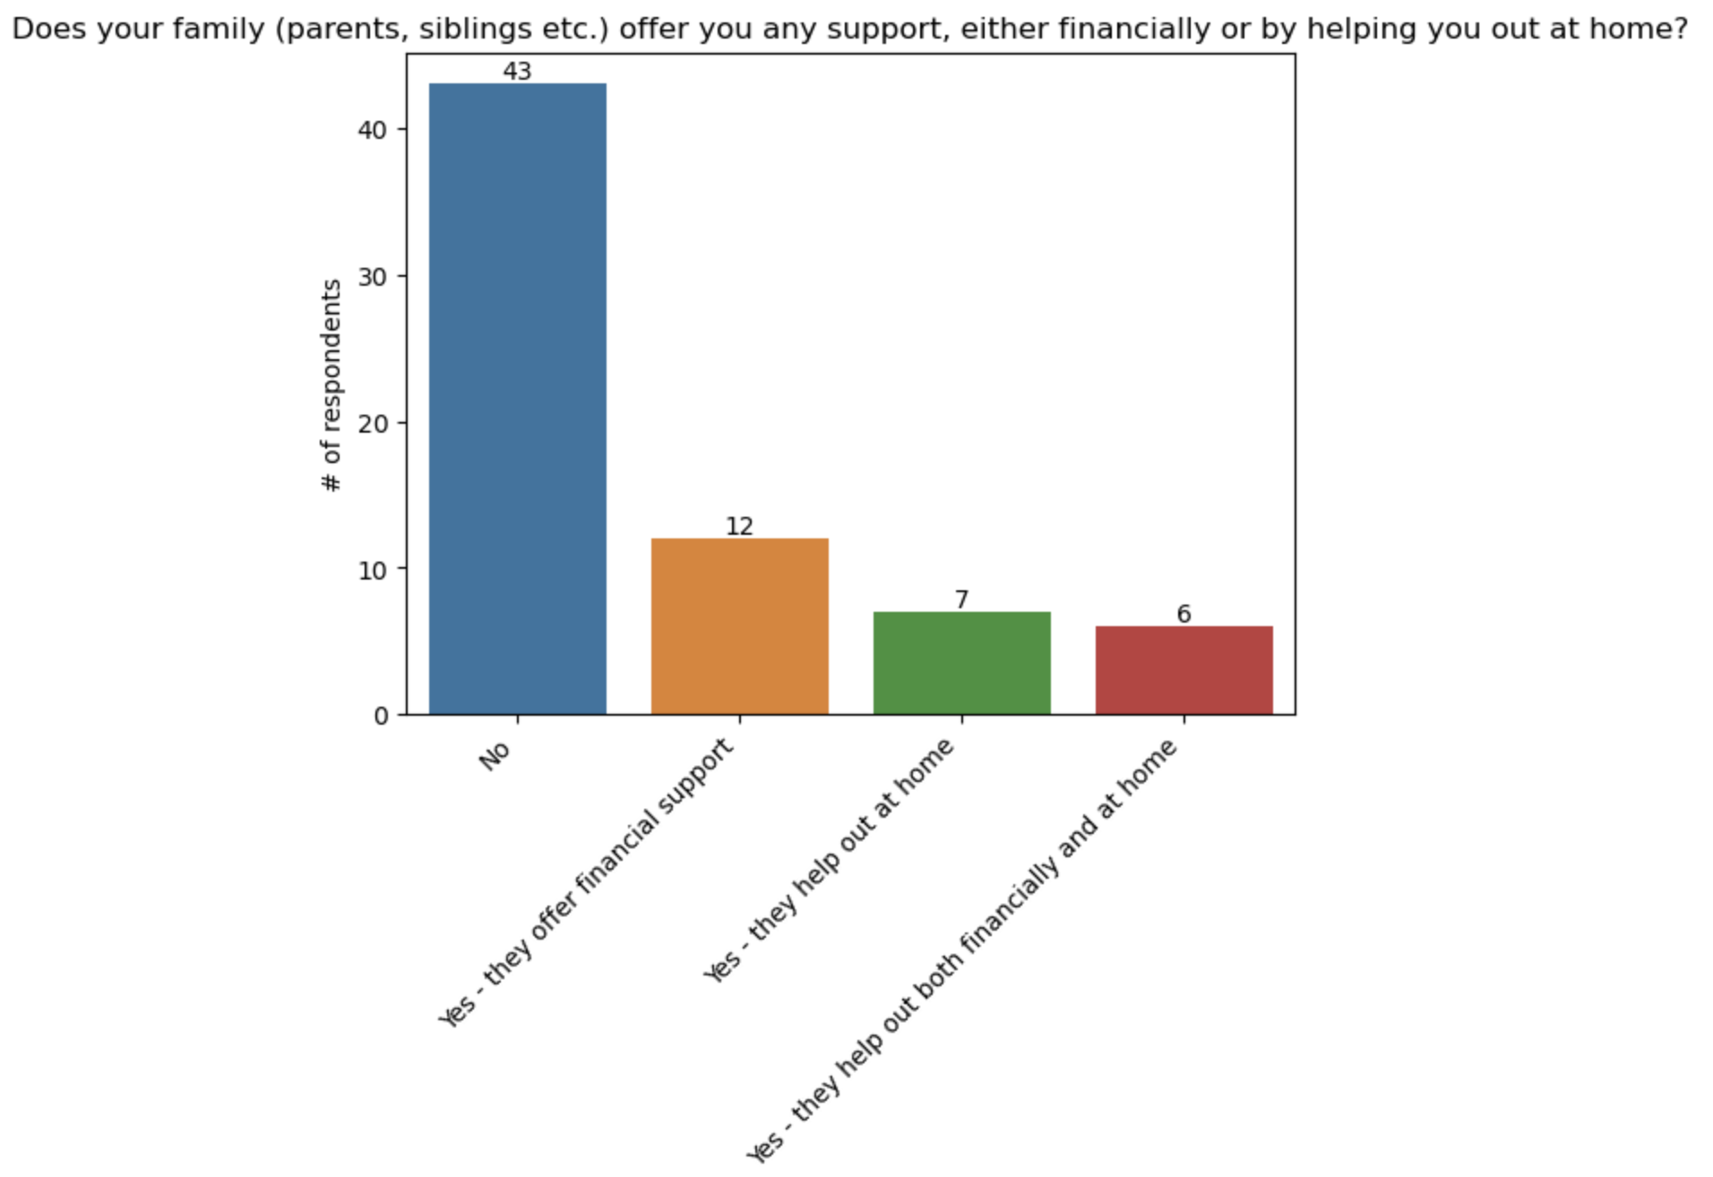
Do postdocs feel financially secure?
Majority of respondents do not feel financially secure
Majority of respondents do not receive any support from family
Notes:
104 people answered the survey

Slide 9
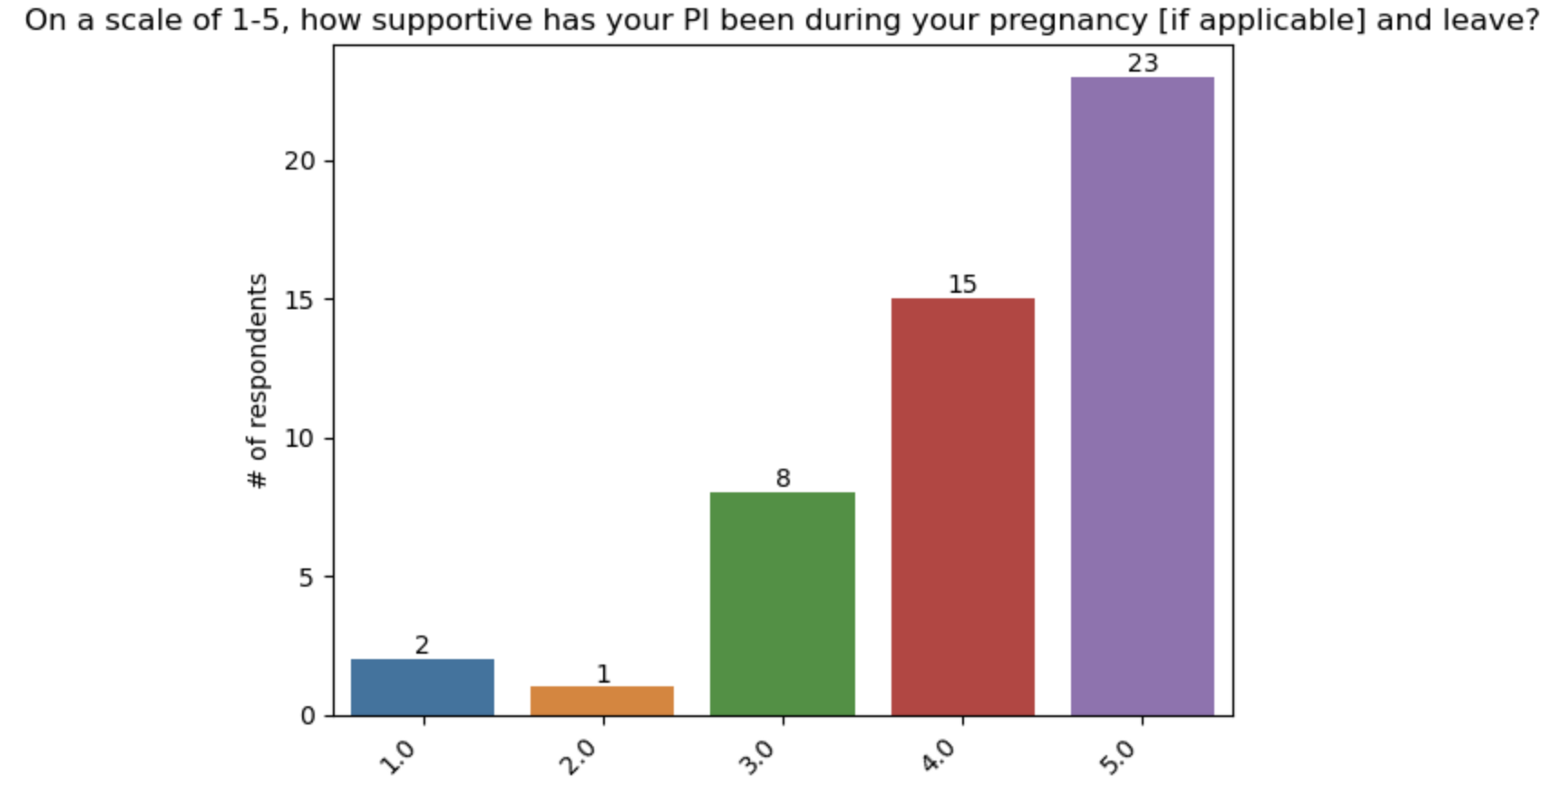
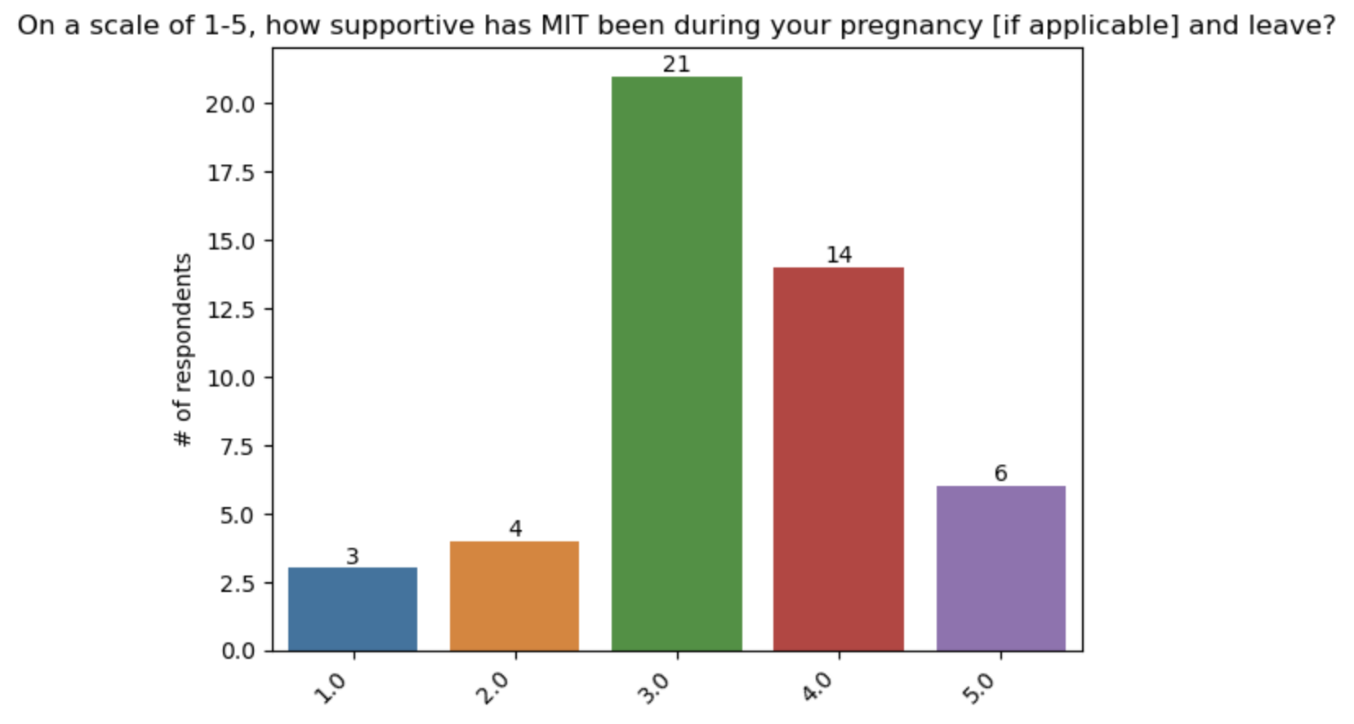
Do postdocs feel supported by their PI and MIT?
Majority of respondents feel their PI was supportive during their pregnancy and leave
Majority of respondents feel neutral about MIT’s support during their pregnancy and leave
Notes:
104 people answered the survey

Slide 10
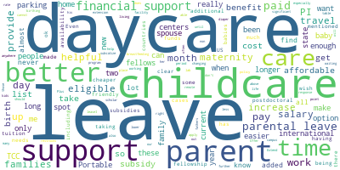
Policies that MIT could adopt for postdoc parents
More affordable daycare
More accessible daycare
Transparency about daycare waitlist
Transparency about leave policies between associates and fellows
Longer parental leave for non-birthing parent
Option to take longer maternity leave
More support for family housing
More institutional support for navigating leave policies
Better financial support (e.g., salary, child support)
Notes:
104 people answered the survey

Slide 11
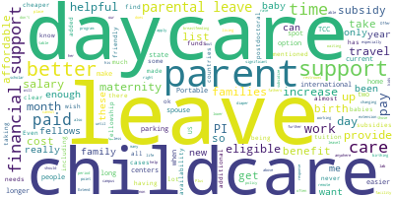
What else should leadership know about being a postdoc parent?
“The cost of childcare makes it hard to continue to be a postdoc at MIT”
“There are a large number of postdocs who want to have a family but put it off because of the conditions”
“Having a child in the Boston area is incredibly expensive and the salary at MIT does not allow for a comfortable position as a parent.”
“1 bedroom apartment in the Boston area is around $2500-$3000, 5-days daycare at MIT is $3000. Life of a postdoc (even with a partner who is working) is miserable.”
“Foreign postdocs don't have their families to help them with a newborn or take care of the other child when there is a new baby.”
Notes:
104 people answered the survey

